Slide 1
Customer leads prediction
SANTHOSH S
DMT6

Slide 2
Problem Statement
the edu-tech company generates leads through various sources. the marketing and sales teams want to optimize their lead conversion rates and improve the efficiency of their lead management process.

Slide 3
Tools Used
Python: Data processing and model building
Pandas & NumPy: Data manipulation
Seaborn & Matplotlib: Data visualization
Scikit-learn: Machine learning model
Power BI/Tableau: Dashboard creation

Slide 4
Approach
Data Loading and Cleaning
Exploratory Data Analysis (EDA)
Feature Selection
Model Building (Logistic Regression)
Model Evaluation
Visualization and Dashboard

Slide 5
EDA Insights

Slide 6
Data Overview
The dataset contains information about leads, their activities, and preferences. Key columns include:
Lead Source
Total Website Visits
Time Spent on Platform
Email Campaign Opens
Job Role
Target Variable:
Converted: Whether the lead converted into a customer (1) or not (0).

Slide 7
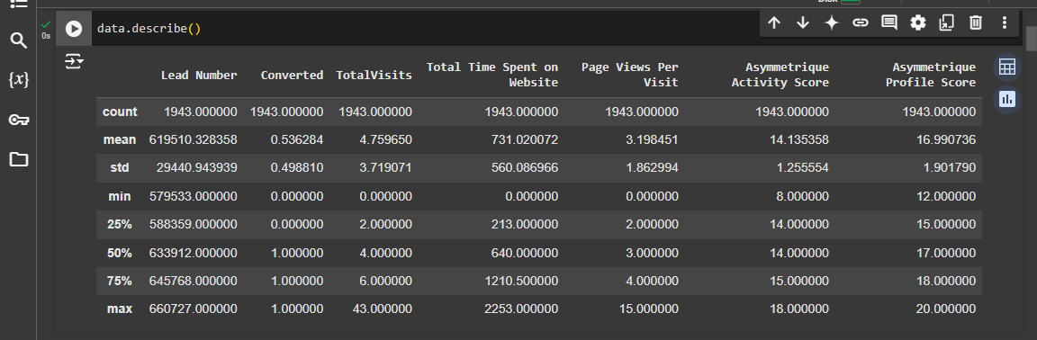
Data Description

Slide 8
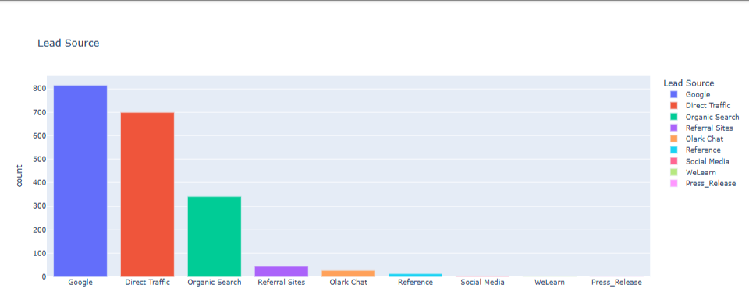
Lead Source
Google count of 814
Direct Traffic of 689
Organic Search of 341
Referral Site of 45
Olark Chat of 27
Leads with more website visits are more likely to convert.

Slide 9
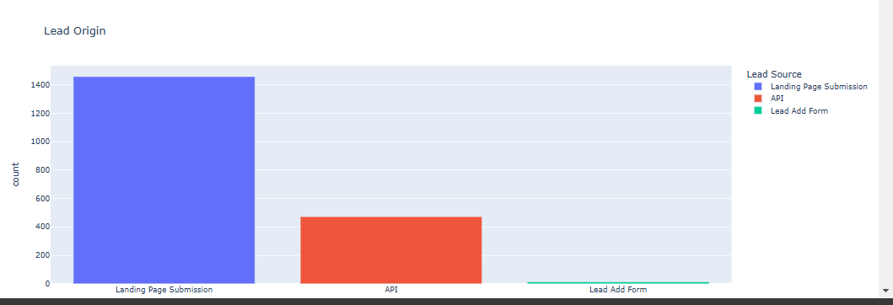
Lead Origin
Landing page submission user 1458
API user 472
Lead add form user 13

Slide 10
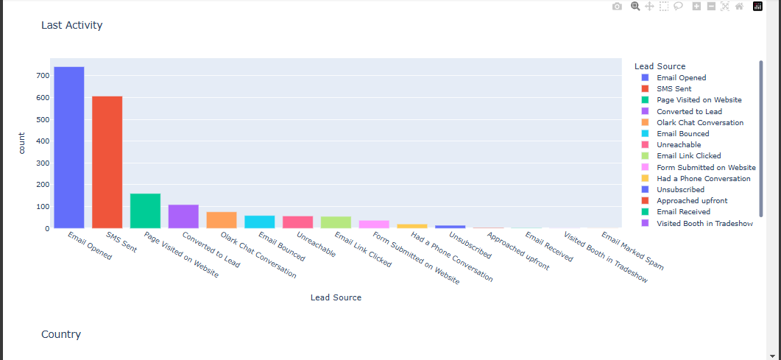
Last Activity conversion rates.
Number of Email opened 742
Number of SMS Sent no 607
Number of Page Visited on website 160
Number of Converted to Lead 109
Email campaign interactions positively impact conversion rates.

Slide 11
Model Building
Model Used: Logistic Regression
Train a logistic regression model.
Evaluate the model using accuracy, precision, recall
Model Evaluation
Accuracy: 79%
Precision: 80%
Recall: 80%

Slide 12
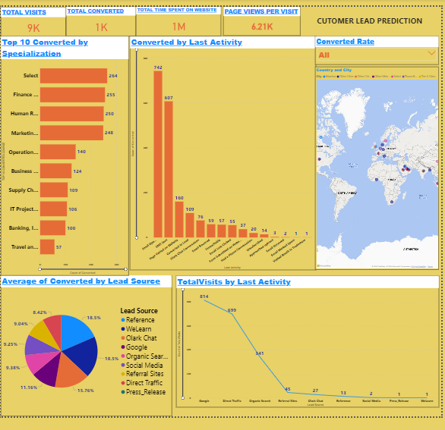
Dash board of power bi

Slide 13
Conclusion/Suggestion like:
Which leads are most likely to convert into paying customers ?
Google lead most using customers paying customers
2. How can the platform prioritize and allocate resources to leads with the highest conversion ?
Improve email content and timing.
SMS Create lead segments and tailor marketing messages

Slide 14
4. How can the lead management process be streamlined and made more effective?
Use predictive modeling to score leads based on their likelihood to convert. This helps the sales team focus on high-priority leads, saving time and improving conversion rates.

Slide 15
Thank you…

